Slide 1


WELCOME!!
W
Ch2
Ch3
Ch4
Ch5
Ch6
Welcome
Lit. Review
Methodology
Design
Results
Introduction & Conclusions
1st part of the guided research track (GRT)
RRSG Seminar
Prepared by Dr. Simon Winberg
Guided Research Track (GRT!)
Notes:
This presentation was prepared for the ‘guided research track’ (GRT) for students starting on a research thesis.

Slide 2
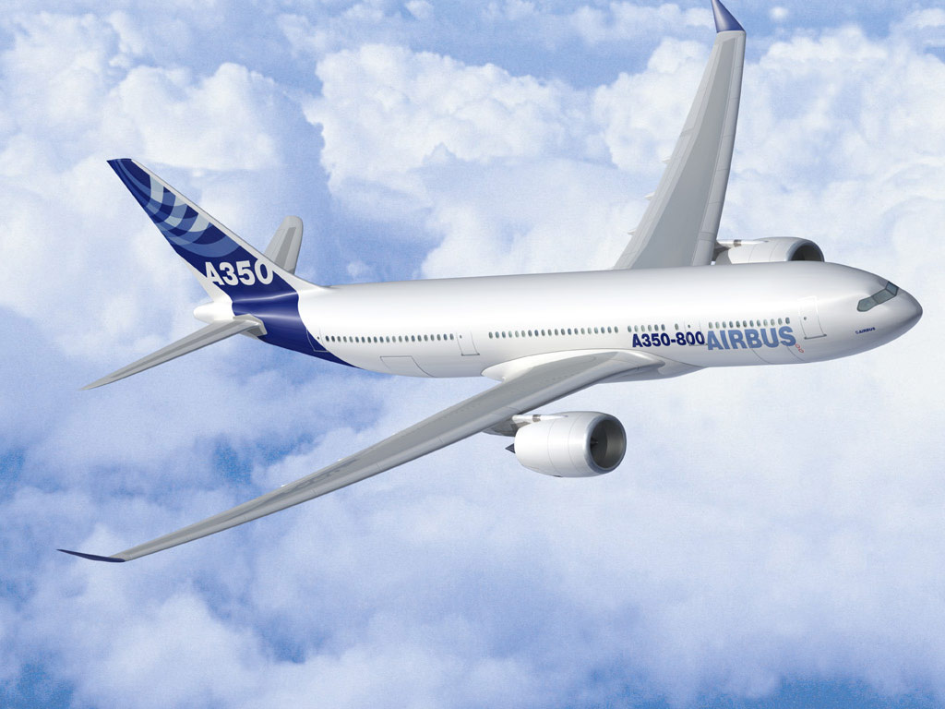
Welcome
EEE4022
Flight EEE4022 is departing…
Get your ‘captain’s training’ now!

Slide 3
The GRT?
What is the Guided Research Track (GRT)
Basically it’s just the name for our group-based project guidance meetings, and the accompanying slides and activities
So… Let’s get started!!

Slide 4
Today’s Agenda
Let’s get things started with My 2 minute brief Introductory Spiel
Over to you: Introductions & the ‘big rocks’
Back to me: brief on the phases
ELO tracking form (assignment for next week)
Closing the meeting & invitation for further discussion for those who have more questions

Slide 5

Last boarding call for
Flight Captains!
There aren’t any passengers on these flights!

Slide 6
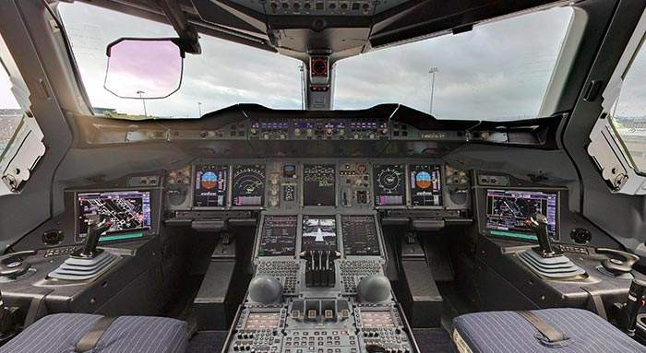


Who’s in charge of this flight?
You are!
Flight EEE4022
Place your face here

Slide 7
You decide if it’s going to be…

Slide 8
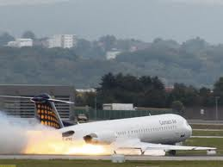
You decide if it’s going to be…
55%
A heavy landing… it’s touch and go if anyone is going to get out alive…

Slide 9
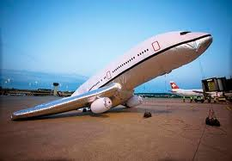
You decide if it’s going to be…
50%
Pfffssssst
A damp squib of a project…
(something you don’t want to draw notice to…)

Slide 10
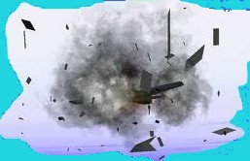
You decide if it’s going to be…
Kaboom!
40%
… an unmentionable devastation …
OR …

Slide 11
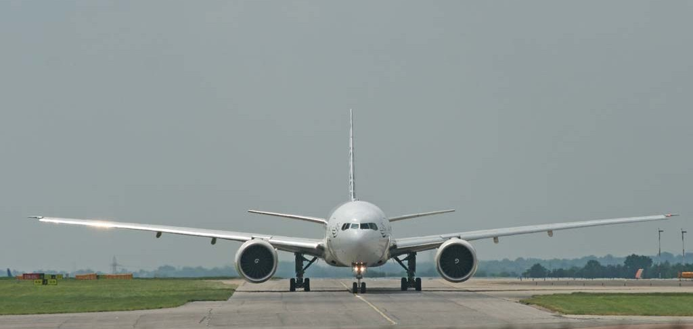


You decide if it’s going to be…
80%
A happy landing ☺
Thank you for travelling flight EEE4022.
Have a good career!

Slide 12
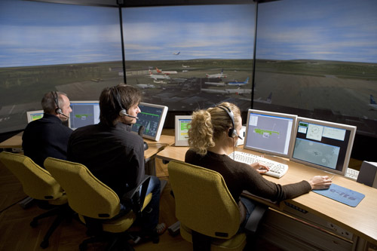
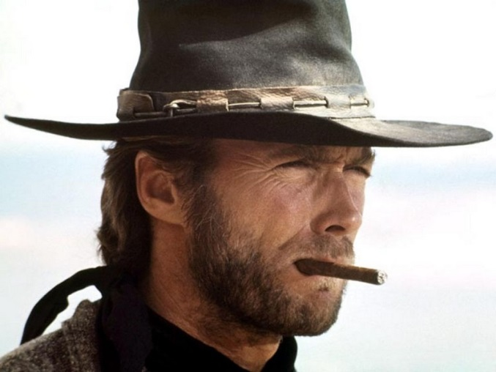
And your supervisor?
Think of him/her as an ATC…
Your supervisor is a bit more
than an air traffic controller:
Helps provide:
Advice
Suggestions
Guidance
Equipment & resources
Go ahead… make my day
Actually…
ATC Tower
But it’s up to you also to show the ATC where you’re at and your intentions, they can’t help you navigate if you can’t show where you are at.

Slide 13
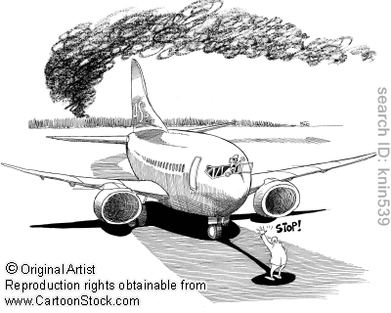
Depending on time availability
We might at times be a bit more hand-on at the runway…

Slide 14

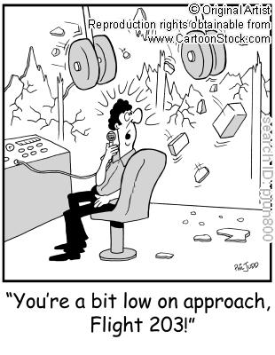
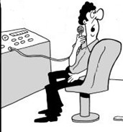
Keep in mind…
We can’t always have a super-quick response, academics typically
have many different things on the go at the same time…
Hey! I’m all done!
Going to submit soon.
Craaash!
But… but wait! I haven’t seen your work
…
You’re a bit too low on
approach flight EEE4022!
Ouch! Too late…

Slide 15
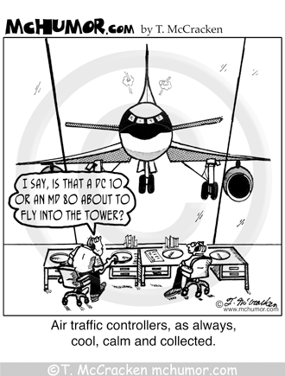
But we’ll try to stay…
“Cool, calm and collected”

Slide 16
Where to start?
Start by understanding your topic
Prepare a draft introduction
Do a literature study
Start the design and implementation

Slide 17
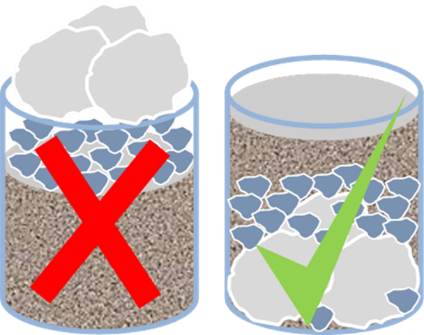
The Big Rocks First
You might have heard this famous quote of:
“Put The Big Rocks In First!” - Dr. Stephen R.Covey*
This relates more to self improvement / life planning (which is more Dr. Covey’s focus) but this ‘manta’ is suited to other projects too.
Basically this is thinking about important things you want to accomplish and concerns making time to get those important issues done and leaving remaining time to less important things.
Translation to a BSc project context: make sure you focus enough time working on the important aspects of your project and don’t get side-tracked on less important issues (like obsessive email checking and thinking about what you should be doing instead of doing it).
Big rock scenario **
* Relates to the bestseller book by Covey “The 7 habits of highly effective people”.
** Read the classic scenario at http://www.appleseeds.org/big-rocks_covey.htm

Slide 18


But now your turn to talk…
Round table introductions and mention of your topic
Hello! This is my rock#1
Each person has +- 60s to introduce themselves, their topic and their (abstract) ‘rocks’.
Indicate: topic title, supervisor(s), a brief synopsis of your project objective. From your project plan (that you were supported to do for today) indicate the biggest ‘rocks’ (see previous slide) that you will focused on in a) lit review b) project. (1 rock for each is fine)

Slide 19
Back to me for a moment…

Slide 20


Story of …
Robert
and
Susan

Slide 21
Let’s consider the plan of attack

Slide 22
The first month and a bit (phase 1)
A suggested approach
start
You are here (?!)
Initial meeting with supervisor
Working on this…
The Proposal
Start Literature
Review (take1)
(done already!!)
Try to complete next week
Deciding on & ordering components
…And this
continues
Prepare Initial Attempt at ELO tracking form
Start next week
Design & Develop
To submit this week
Plan your Methodology and experiments
Revise Literature
In 2-3 weeks time

Slide 23


Planning Tools: MindMaps
Mind maps are really useful to getting ideas down as a conceptual representation, and connecting related concepts.
This is often useful as an initial step, possibly just pencil on paper, in deciding what needs to be done and dependencies between things.
http://www.xmind.net/ (free mind mapping software)
Suggested
software:
http://connected-mind.appspot.com/ (avail as Chrome App)

Slide 24
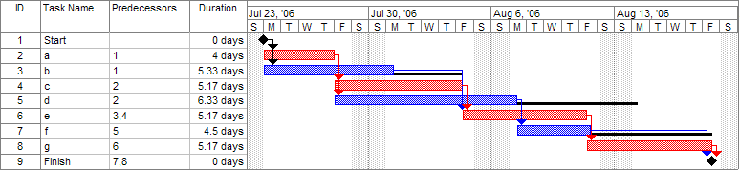
Planning Tools: Gantt Chart
Gantt Chart
Good to keep track of tasks, calculate completion times, task dependencies
Also can keep track of milestones and % completion status of tasks
This can be useful for inclusion into writeup
Example Gantt Chart showing task dependencies
Image source: https://en.wikipedia.org/wiki/File:Pert_example_gantt_chart.gif

Slide 25
Planning Tools: Gantt Chart
ProjectLibre an open-source project management tool like MS Project: https://sourceforge.net/projects/projectlibre/
GanttProject is an opensource tool avail: https://sourceforge.net/projects/ganttproject/
You can get Microsoft Project from ICTS (minor cost of CD)

Slide 26
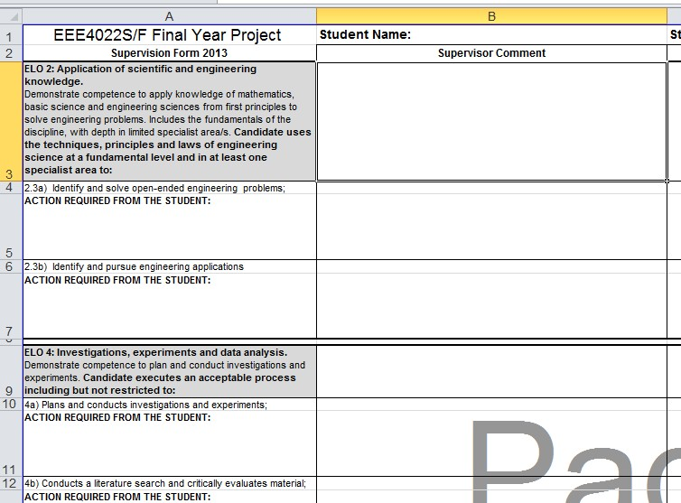
The ELO Form
Please start filling these in…
Please make a
Start on this &
Submit your initial attempt on VULA before the next meeting

Slide 27

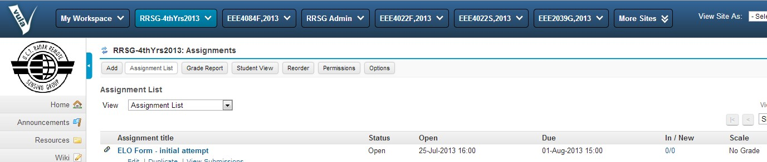
Task #1 : The ELO Form
Submit your draft on VULA (to help your supervisor avoid loosing your form!)
Let’s have a quick look at a sample and ideas for filling things in…

Slide 28
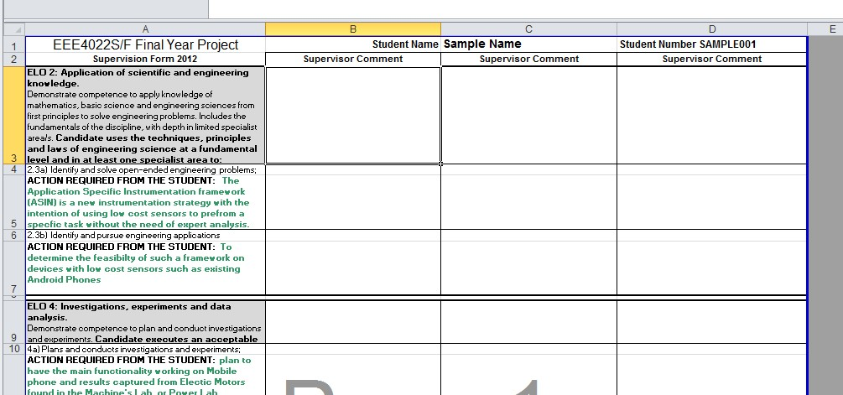
ELO Sample
Student is meant to describe the
action to be carried out
Supervisor is meant to document response to
Attempt 1*
Attempt 2
Attempt 3
* Technically, you are supposed to have 3x attempts in which to satisfy an exit level outcome (ELO) and the 3x columns are used to record this. Mostly it is achieved in the first attempt. The supervisor comments columns can probably be used also for co-supervisor comments if needed.

Slide 29

ELO Tracking
Which one to start with?
Consider: ELO2 -> ELO10 -> ELO8 -> ELO6 -> ELO4
Example (this is just a make-up description, in red, showing what a student would provide)
ELO 2: Application of scientific and engineering knowledge. Demonstrate competence to apply knowledge of mathematics, basic science and engineering sciences from first principles to solve engineering problems. Includes the fundamentals of the discipline, with depth in limited specialist area/s. Candidate uses the techniques, principles and laws of engineering science at a fundamental level and in at least one specialist area to:
2.3a) Identify and solve open-ended engineering problems;
ACTION REQUIRED FROM THE STUDENT: The XYZ sensor product is a novel instrumentation strategy intended for low cost sensors to perform a specific task without the need of further analysis. To test this framework the student will develop an experimental C application that runs on an embedded platform.
2.3b) Identify and pursue engineering applications
ACTION REQUIRED FROM THE STUDENT: Determine the feasibility of using such a sensing framework on devices with low cost sensors such as components R1 and D2 from vendor CheapPlace1.
YOU
Provide
ELO2 is just reiterating some points about expected design work related to your topic. You can probably have an idea for before doing a lit review.

Slide 30
ELO Tracking
Consider: ELO2 -> ELO10 -> ELO8 -> ELO6 -> ELO4
ELO 10: Engineering professionalism Demonstrate critical awareness of the need to act professionally and ethically and to exercise judgment and take responsibility within own limits of competence. Candidate exhibits professionalism by the following:
10c) Accepts responsibility for own actions;
ACTION REQUIRED FROM THE STUDENT: Signed plagiarism document as well as a filled out ethics questionnaire.
ELO10 You can probably say pretty much the same thing as my example above.

Slide 31
ELO Tracking
Consider: ELO2 -> ELO10 -> ELO8 -> ELO6 -> ELO4
ELO 8: Candidate demonstrates effective individual work by performing the following:
a) Identifies and focuses on objectives;
ACTION REQUIRED FROM THE STUDENT: Has set objectives and works towards achieving them
b) Works strategically;
ACTION REQUIRED FROM THE STUDENT: Has set goals and works towards achieving them
c) Executes tasks effectively;
ACTION REQUIRED FROM THE STUDENT: Displays efficient use of time while working on project.
d) Delivers completed work on time.
ACTION REQUIRED FROM THE STUDENT: Deliver targets on time
You can use your description and own thoughts for these – basically largely common sense

Slide 32
ELO Tracking
Consider: ELO2 -> ELO10 -> ELO8 -> ELO6 -> ELO4
ELO 6: Professional and technical communication Demonstrate competence to communicate effectively, both orally and in writing, with engineering audiences and the community at large. Written reports range from short (300-1000 words) to long (10k -15k words plus tables, diagrams and appendices).The candidate executes effective written communication as evidenced by:
6.1a) Uses appropriate structure, style and language for purpose and audience;
ACTION REQUIRED FROM THE STUDENT: Formal Report including research done, planning and results as well as formal analysis of results
6.1b) Uses effective graphical support;
ACTION REQUIRED FROM THE STUDENT: Graphs, Tables, Figures and screen shots are used for illustrative purposes
6.1c) Applies methods of providing information for use by others involved in engineering activity;
ACTION REQUIRED FROM THE STUDENT: Report should be interpretable by other engineers and usable for research purposes. Design should be able to be recreated with ease.
6.1d) Meets the requirements of the target audience.
ACTION REQUIRED FROM THE STUDENT: The report should be structured so that it meets the requirements of the electrical engineering audience
You could probably answer most of these without having done any design, but it will likely need refinement later on.

Slide 33

ELO Tracking
Consider: ELO2 -> ELO10 -> ELO8 -> ELO6 -> ELO4
ELO 4: Investigations, experiments and data analysis. Demonstrate competence to plan and conduct investigations and experiments. Candidate executes an acceptable process including but not restricted to:
4a) Plans and conducts investigations and experiments;
ACTION REQUIRED FROM THE STUDENT: plan to have the main functionality working on the embedded platform and results captured from the sensors set up in the lab… maybe ?? Depends on your project.
4b) Conducts a literature search and critically evaluates material;
ACTION REQUIRED FROM THE STUDENT: …
4c) Performs necessary analyses;
ACTION REQUIRED FROM THE STUDENT:
4d) Selects and uses appropriate equipment or software;
4e) Analyses, interprets and derives information from data;
4f) Draws conclusions based on evidence;
4g) Communicates the purpose, process and outcomes in a technical report.
Basically ELO4 has questions that are more specific to your project… you will probably need to wait until you’ve done some design and testing.

Slide 34
A few general issues
&
A terminology moment

Slide 35
Methodology vs. Design vs. Results
Methodology =
What are you going to do in terms of the research
Experiments, data capture methods, data analysis methods
Design / Prototype design chapter =
What you are going to build
Implied from Methodology chapter
Results
Following the methodology, and through the construction and use of the system designed, what was obtained?

Slide 36
Rough breakdown by chapter size
Introduction 4 - 10 pages ~10%
Literature Review 10-15 pages ~15-20%
Methodology 5-10 pages ~10%
Design 10-15 pages ~15%
Results 10-15 pages ~15%
Conclusion 2-5 pages ~10%
Not too
much here!
Don’t be too brief on this
about 30-50% of body
50 pages is OK, 80-100 verging on too much. (excl. Appendices)
Of course the specific chapters chosen may differ, but each
of these aspects must be present somewhere.

Slide 37
Equipment and Software
Limited funds avail for components
Equipment can be booked from Justin Pead
RRSG Envy sever has many licensed tools
UCT licensed MATLAB can be installed on UCT desktop computers in the labs (PG students can be given concession to install on laptops)

Slide 38

Recommendations / Regulations
Page length and word count
18,000 words for a 40 credit BSc project is adequate. Much less than that and one begins to worry about the quanity of work completed.
Reports should be a Maximum 30,000 words, try not to exceed 40 pages in the main body. You can have additional appendices that exceed this total page count and word count.
Considerate writing
Remember that the examiner reading is only human and likely has only a few hours to grade your thesis.
So be smart in structuring the thesis, ensure good flow to the writing, be considerate in forming elegant and easy to read sentences.
Avoid overcomplicated/convoluted sentences.
Good Flow and Elegance

Slide 39
Naming Files / Shared Folders
Please name your files and folders that you share with your supervisor sensibly, as well as naming your final report
Please don’t just name your report something like “report.pdf” or “bscproject.pdf”… please have at least your student number in the report so that it is easier to keep track of, e.g.
“Final Report – Student Name (stdnum001).pdf”
Similar if you crease a google drive folder and share it, call it something like “JoeBlogs_BScProject”

Slide 40
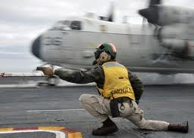
Conclusions
Don’t leave the methodology till too late
It’s making a start on the writing, especially the literature review
But don’t get side-tracked and bogged down with overdoing the literature review
Remember “the big rocks first!”
It is important to get some development done, to show you’ve made and tested something.
Please start on your ELO tracking form!
You’re clear for take-off!!

Slide 41
Q: How to do a good Literature Review?
A preview of the next episode of GRT …
A:
Find out how others did things …. ?
To watch YouTubes for hours on end?
To download masses of papers?
To loose yourself in a [text]book?
To reminisce on more exciting times?
… Maybe. But it’s best to be focused. “Don’t loose track of the forest for the trees” and similar idioms jump to mind.
It’s a good idea to start your Lit Review asap, if you haven’t already.

Slide 42
Assignments
Start filling out your ELO tracking form
Prepare a project plan if you haven’t already got one
Make a start on the literature review, formulating a list of relevant readings and a point-form structure for your literature review chapter. (If you’ve got a more substantial lit review already, that’s excellent, we’ll discuss the lit review further next week)

Slide 43

W
Ch2
Ch3
Ch4
Ch5
Ch6
Welcome
Lit. Review
Methodology
Design
Results
Introduction & Conclusions
Questions?

